Slide 1
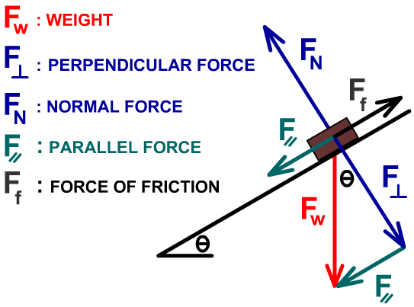
Inclined Planes Review
Any object on a slope experiences a number of forces in different directions:
Weight (F_{W}, F_{g} or W), directly downwards
Normal force (F_{N} or N), perpendicular to and away from the slope
Friction (F_{f} or F_{s}), parallel to the slope and opposite to the direction of movement (usually up the slope)
The weight vector can be resolved into two helpful components:
A component parallel to and down the slope (F_{a} or F∥)
A component perpendicular to and into the slope (-F_{N} or F⊥)
The triangle formed by resolving the weight vector is similar to the triangle formed by the slope.
Notes:
Previously we considered the sum of the forces on the object using vector addition (i.e. F_{a} = F_{W} + F_{N}). This is a different approach that comes to the same conclusions.

Slide 2
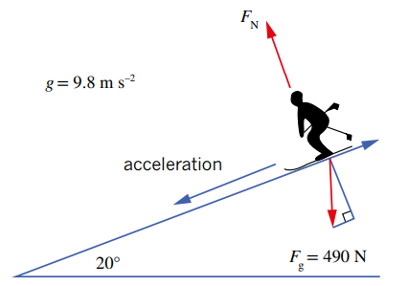
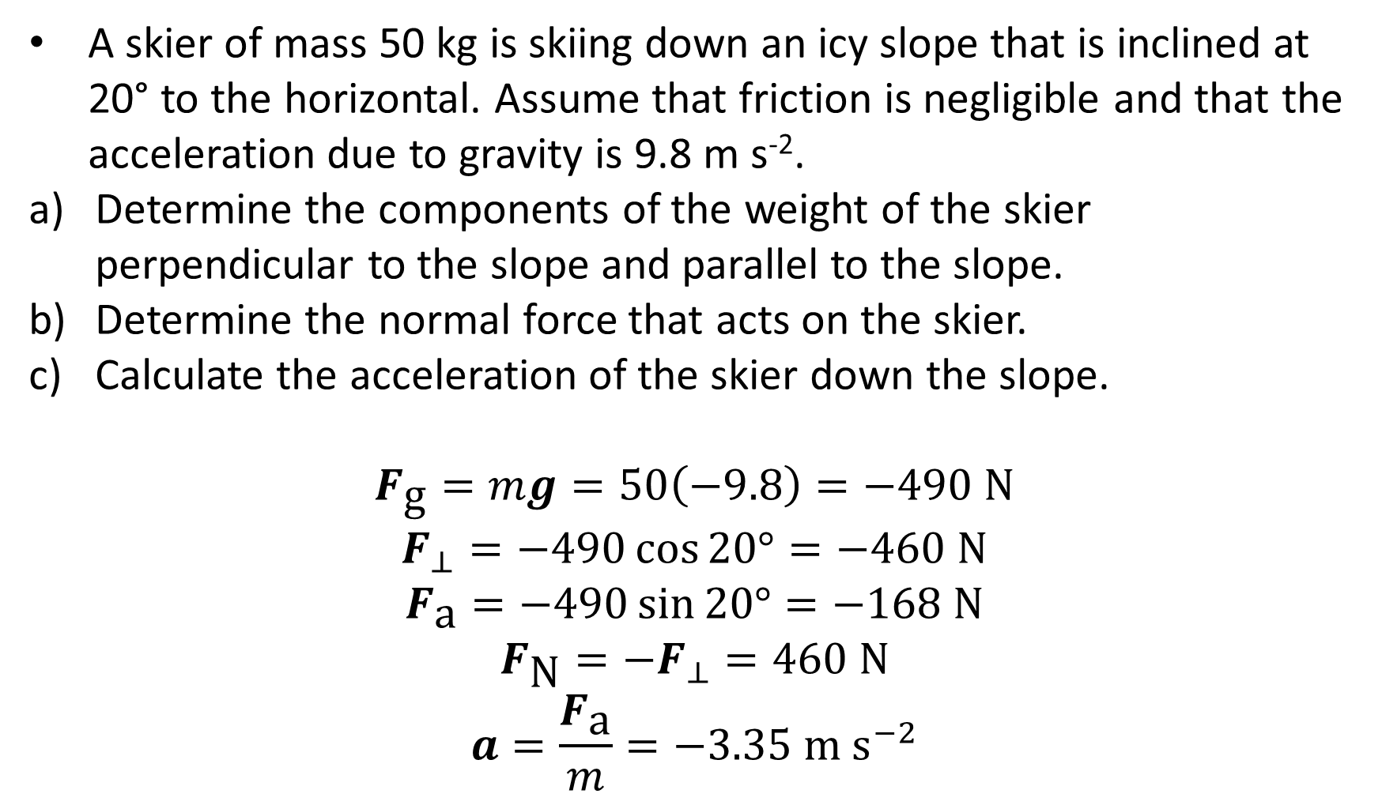
Review Question
A skier of mass 50 kg is skiing down an icy slope that is inclined at 20° to the horizontal. Assume that friction is negligible and that the acceleration due to gravity is 9.8 m s⁻².
Determine the components of the weight of the skier perpendicular to the slope and parallel to the slope.
Determine the normal force that acts on the skier.
Calculate the acceleration of the skier down the slope.
$$F_{\text{g}}=mg=50\left(−9.8\right)=−490 \text{N}$$
$$F_{⊥}=−490\cos{20°}=−460 \text{N}$$
$$F_{\text{a}}=−490\sin{20°}=−168 \text{N}$$
$$F_{\text{N}}=−F_{⊥}=460 \text{N}$$
$$a=\frac{F_{\text{a}}}{m}=−3.35 \text{m} {\text{s}}^{−2}$$

Slide 3
Projectile Motion

Slide 4
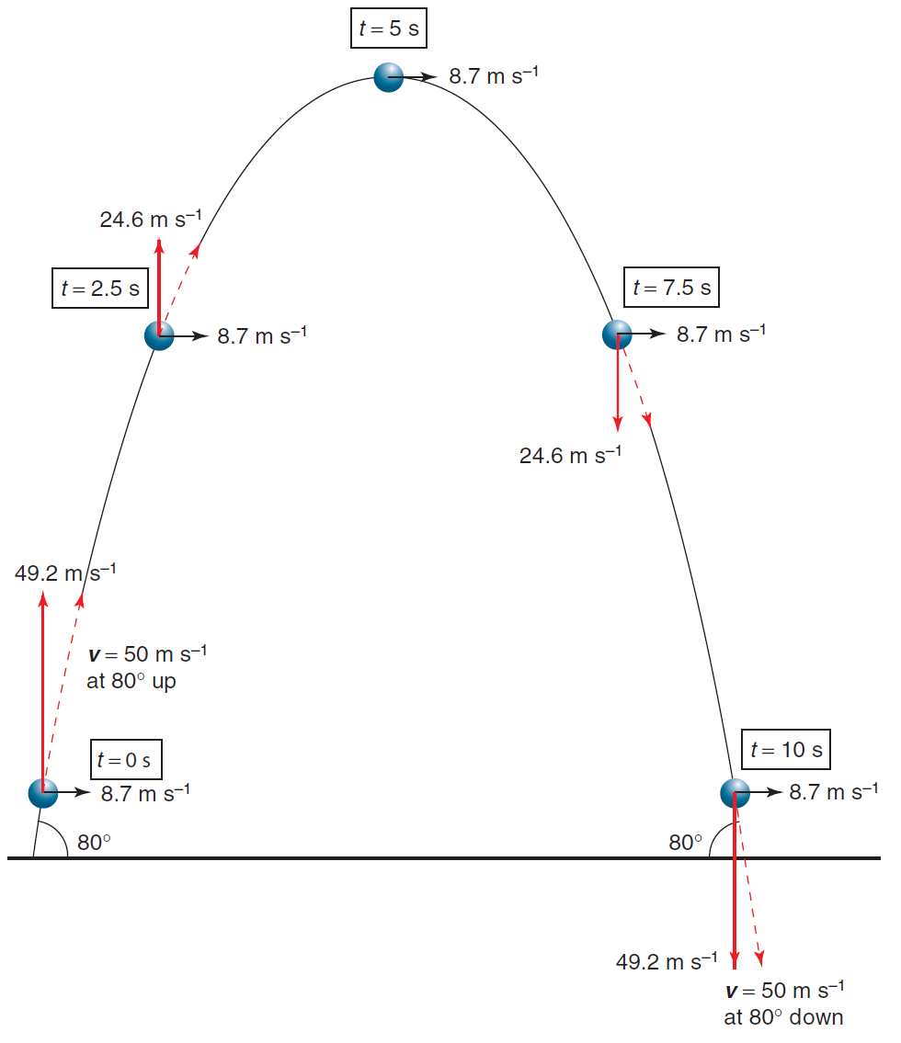
Background
Projectiles are objects that are moving freely through the air.
Air resistance is generally ignored, so the only force acting on them is gravity, which pulls them straight down. As a result:
Their horizontal velocity is constant since there are no horizontal forces acting on them.
Unless they are launched straight up, they follow a symmetrical curved path called a parabola.
Their vertical velocity at the peak of this curve is 0 m s⁻¹.
Their vertical velocity is symmetrical (though it changes direction after the peak).

Slide 5
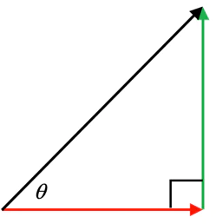
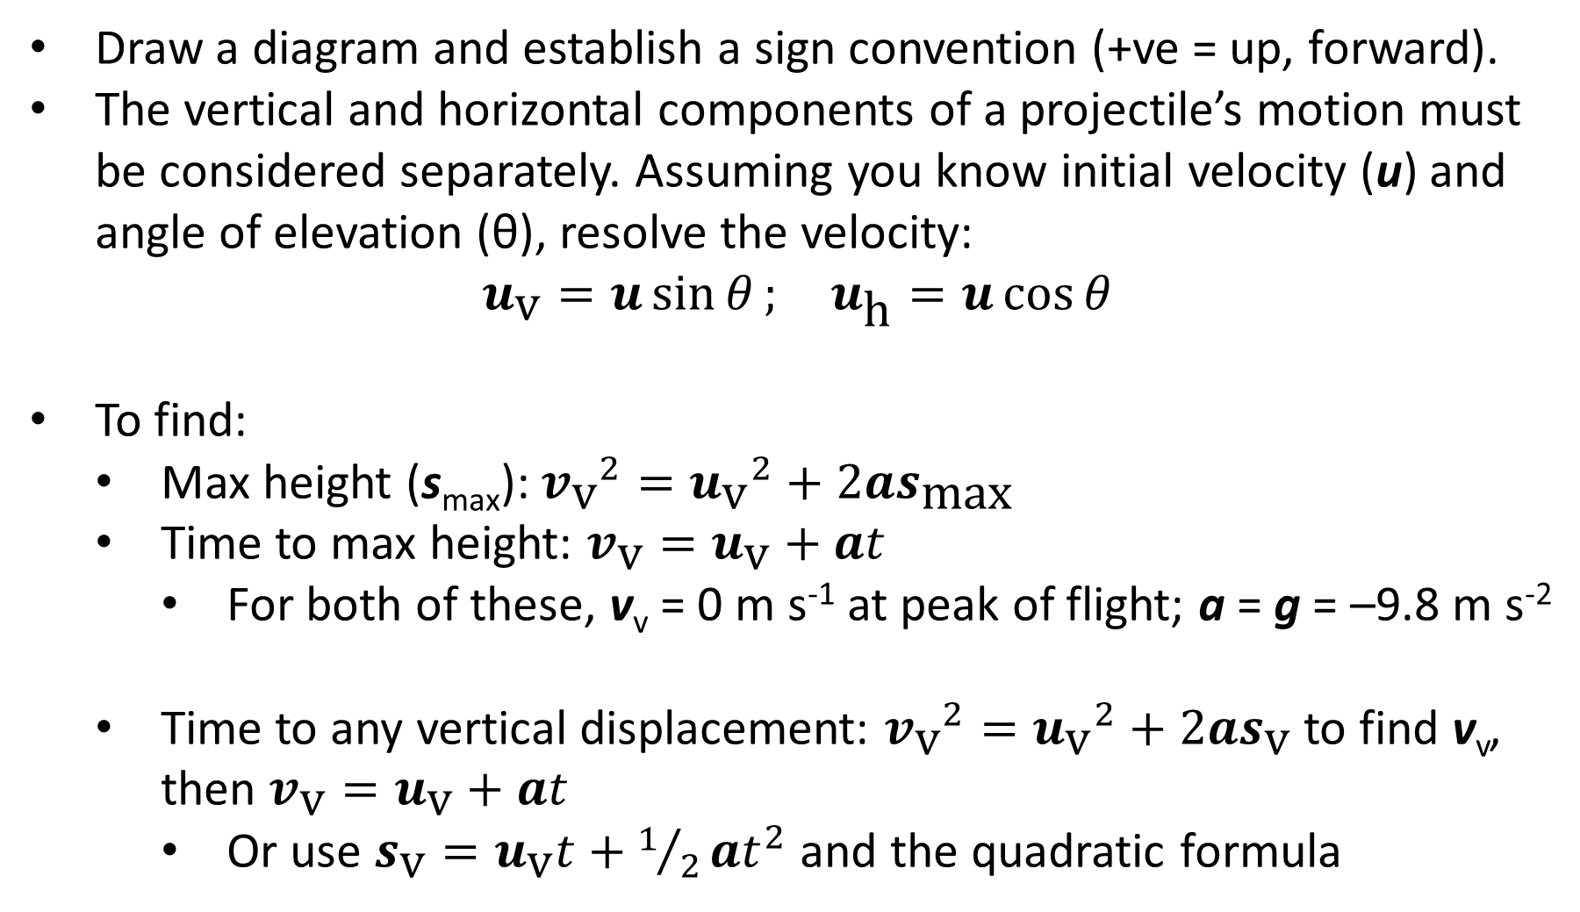
Analysing Projectile Motion
Draw a diagram and establish a sign convention (+ve = up, forward).
The vertical and horizontal components of a projectile’s motion must be considered separately. Assuming you know initial velocity (u) and angle of elevation (θ), resolve the velocity:
$$u_{\text{v}}=u\sin{θ}; u_{\text{h}}=u\cos{θ}$$
To find:
Max height (s_{max}): ${v_{\text{v}}}^{2}={u_{\text{v}}}^{2}+2as_{\text{max}}$
Time to max height: $v_{\text{v}}=u_{\text{v}}+at$
For both of these, v_{v} = 0 m s⁻¹ at peak of flight; a = g = –9.8 m s⁻²
Time to any vertical displacement: ${v_{\text{v}}}^{2}={u_{\text{v}}}^{2}+2as_{\text{v}}$ to find v_{v}, then $v_{\text{v}}=u_{\text{v}}+at$
Or use $s_{\text{v}}=u_{\text{v}}t+1/2at^{2}$ and the quadratic formula
u
u_{v}
u_{h}

Slide 6
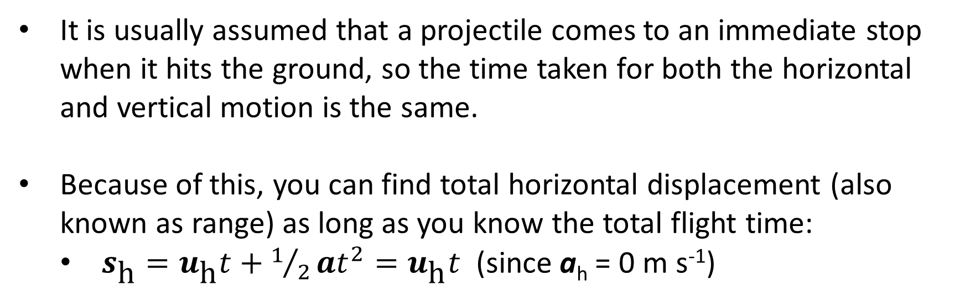
Analysing Projectile Motion
It is usually assumed that a projectile comes to an immediate stop when it hits the ground, so the time taken for both the horizontal and vertical motion is the same.
Because of this, you can find total horizontal displacement (also known as range) as long as you know the total flight time:
$s_{\text{h}}=u_{\text{h}}t+1/2at^{2}=u_{\text{h}}t$ (since a_{h} = 0 m s⁻¹)

Slide 7
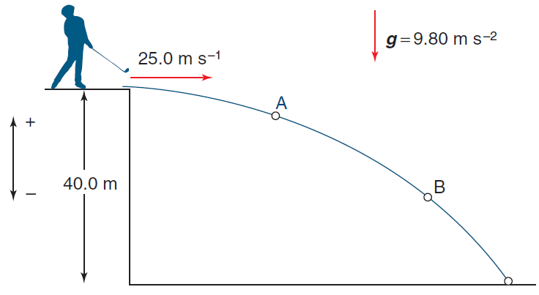
Example #1
A golf ball of mass 64.0 g is hit horizontally from the top of a 40.0 m high cliff with a speed of 25.0 m s⁻¹. Assuming that the acceleration due to gravity is 9.80 m s⁻² and ignoring air resistance, calculate the:
time that the ball takes to land
distance that the ball travels from the base of the cliff
velocity of the ball as it lands
net force acting on the ball at points A and B
acceleration of the ball at points A and B

Slide 8
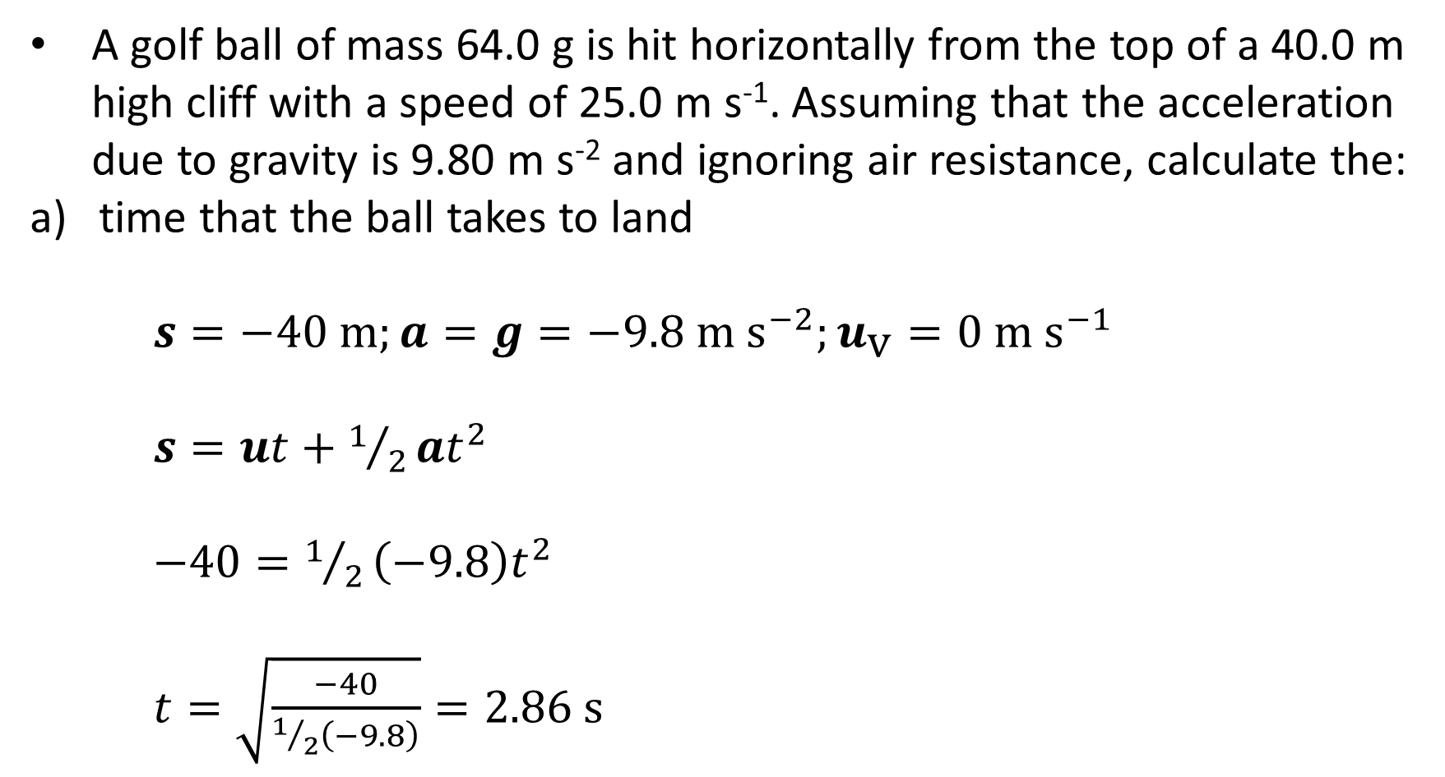
Example #1
A golf ball of mass 64.0 g is hit horizontally from the top of a 40.0 m high cliff with a speed of 25.0 m s⁻¹. Assuming that the acceleration due to gravity is 9.80 m s⁻² and ignoring air resistance, calculate the:
time that the ball takes to land
$s=−40 \text{m};a=g=−9.8 \text{m} {\text{s}}^{−2};u_{\text{v}}=0 \text{m} {\text{s}}^{−1}$
$s=ut+1/2at^{2}$
$−40=1/2\left(−9.8\right)t^{2}$
$t=\sqrt{\frac{−40}{1/2\left(−9.8\right)}}=2.86 \text{s}$

Slide 9
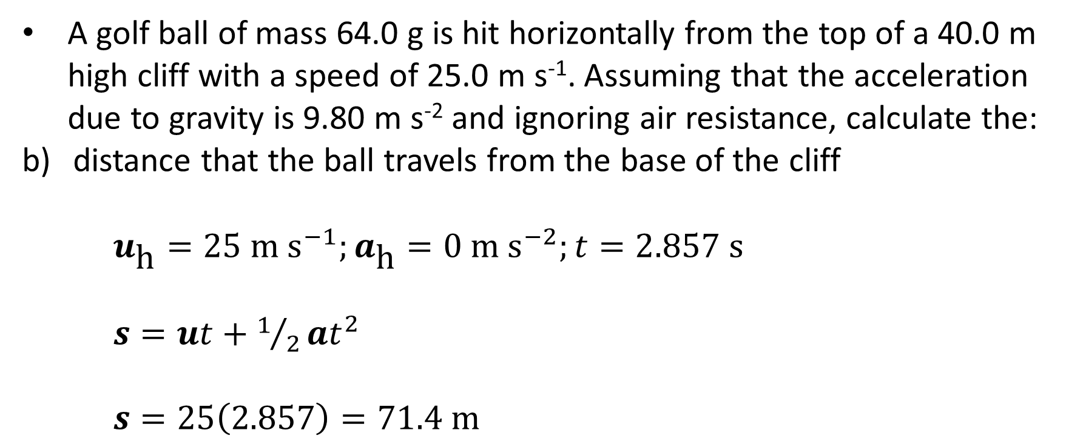
Example #1
A golf ball of mass 64.0 g is hit horizontally from the top of a 40.0 m high cliff with a speed of 25.0 m s⁻¹. Assuming that the acceleration due to gravity is 9.80 m s⁻² and ignoring air resistance, calculate the:
distance that the ball travels from the base of the cliff
$u_{\text{h}}=25 \text{m} {\text{s}}^{−1};a_{\text{h}}=0 \text{m} {\text{s}}^{−2};t=2.857 \text{s}$
$s=ut+1/2at^{2}$
$s=25\left(2.857\right)=71.4 \text{m}$

Slide 10
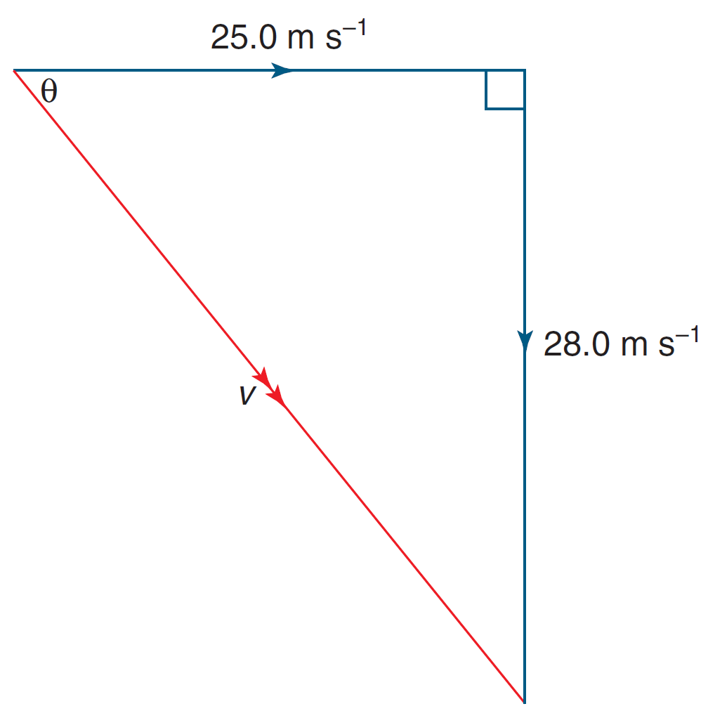
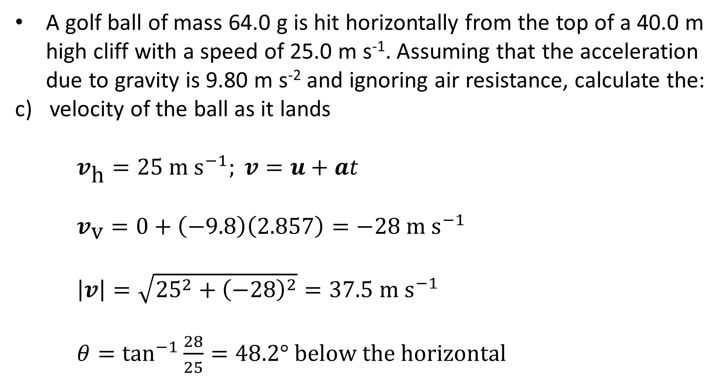
Example #1
A golf ball of mass 64.0 g is hit horizontally from the top of a 40.0 m high cliff with a speed of 25.0 m s⁻¹. Assuming that the acceleration due to gravity is 9.80 m s⁻² and ignoring air resistance, calculate the:
velocity of the ball as it lands
$v_{\text{h}}=25 \text{m} {\text{s}}^{−1}; v=u+at$
$v_{\text{v}}=0+\left(−9.8\right)\left(2.857\right)=−28 \text{m} {\text{s}}^{−1}$
$\left|v\right|=\sqrt{{25}^{2}+{\left(−28\right)}^{2}}=37.5 \text{m} {\text{s}}^{−1}$
$θ=\tan^{−1}{\frac{28}{25}}=48.2° \text{below} \text{the} \text{horizontal}$

Slide 11
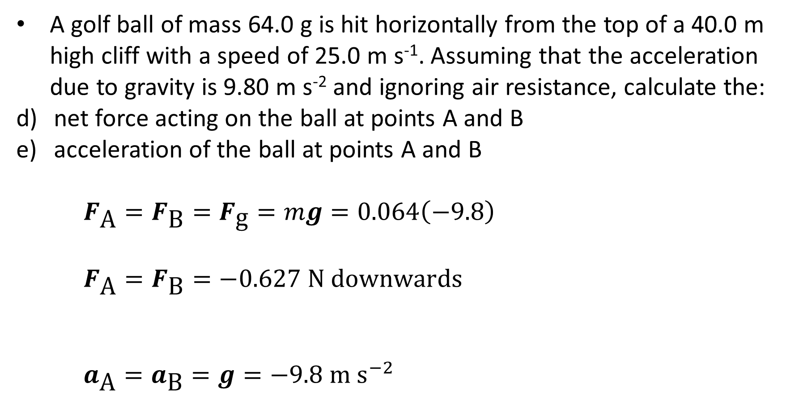
Example #1
A golf ball of mass 64.0 g is hit horizontally from the top of a 40.0 m high cliff with a speed of 25.0 m s⁻¹. Assuming that the acceleration due to gravity is 9.80 m s⁻² and ignoring air resistance, calculate the:
net force acting on the ball at points A and B
acceleration of the ball at points A and B
$F_{\text{A}}=F_{\text{B}}=F_{\text{g}}=mg=0.064\left(−9.8\right)$
$F_{\text{A}}=F_{\text{B}}=−0.627 \text{N} \text{downwards}$
$a_{\text{A}}=a_{\text{B}}=g=−9.8 \text{m} {\text{s}}^{−2}$

Slide 12
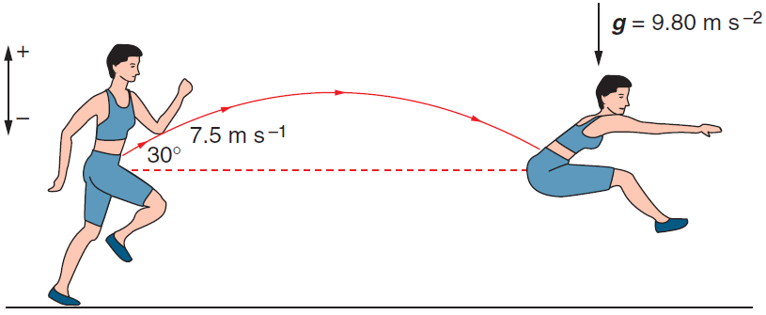
Example #2
A 65.0 kg athlete in a long-jump event leaps with a velocity of 7.50 m s⁻¹ at 30.0° to the horizontal. Treating the athlete as a point mass, ignoring air resistance, and using g as −9.80 m s⁻², calculate the:
horizontal component of the initial velocity
vertical component of the initial velocity
velocity when at the highest point
maximum height gained by the athlete
total time for which the athlete is in the air
horizontal distance travelled by the athlete’s centre of mass (assuming that it returns to its original height)
athlete’s acceleration at the highest point of the jump
Notes:
6.50 m s⁻¹
3.75 m s⁻¹
6.50 m s⁻¹ horizontally
0.717 m
0.765 s
4.97 m
-9.80 m s⁻²

Slide 13
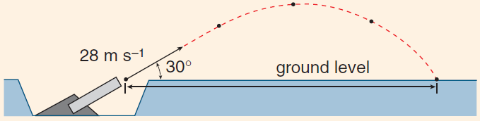
Example #3
A physics class researching projectile motion constructs a device that can launch a cricket ball. The launching device is designed so that the ball can be launched at ground level with an initial velocity of 28.0 m s⁻¹ at an angle of 30.0° to the horizontal.
Calculate the vertical component of the velocity of the ball:
initially
after 2.00 s
At what time will the ball reach its maximum height?
What is the ball's minimum speed during its flight?
Calculate the horizontal range of the ball.
Notes:
ai) 14.0 m s⁻¹
aii) -5.60 m s⁻¹
b) 1.43 s
c) 24.2 m s⁻¹
d) 69.3 m

Slide 14
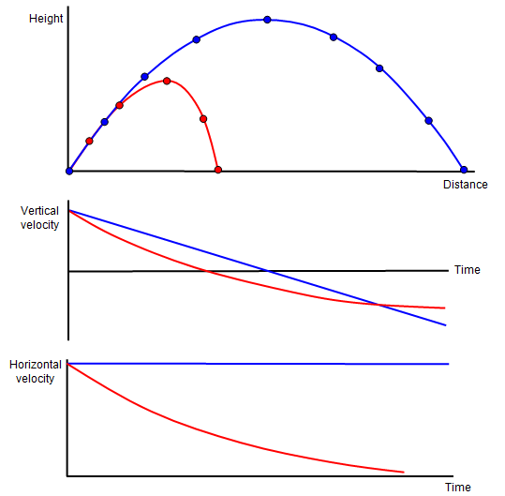
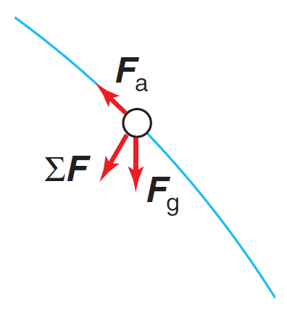
Air Resistance
Air resistance (F_{a}, also known as drag, F_{d}) alters the flight of a projectile in a number of ways:
The net force on the object is no longer straight down: it has a negative horizontal component (until v_{h} = 0).
As a result, a_{h} is no longer zero: it is now negative (again, until v_{h} = 0).
The projectile’s flight path and velocity is no longer parabolic or symmetrical.

Slide 15
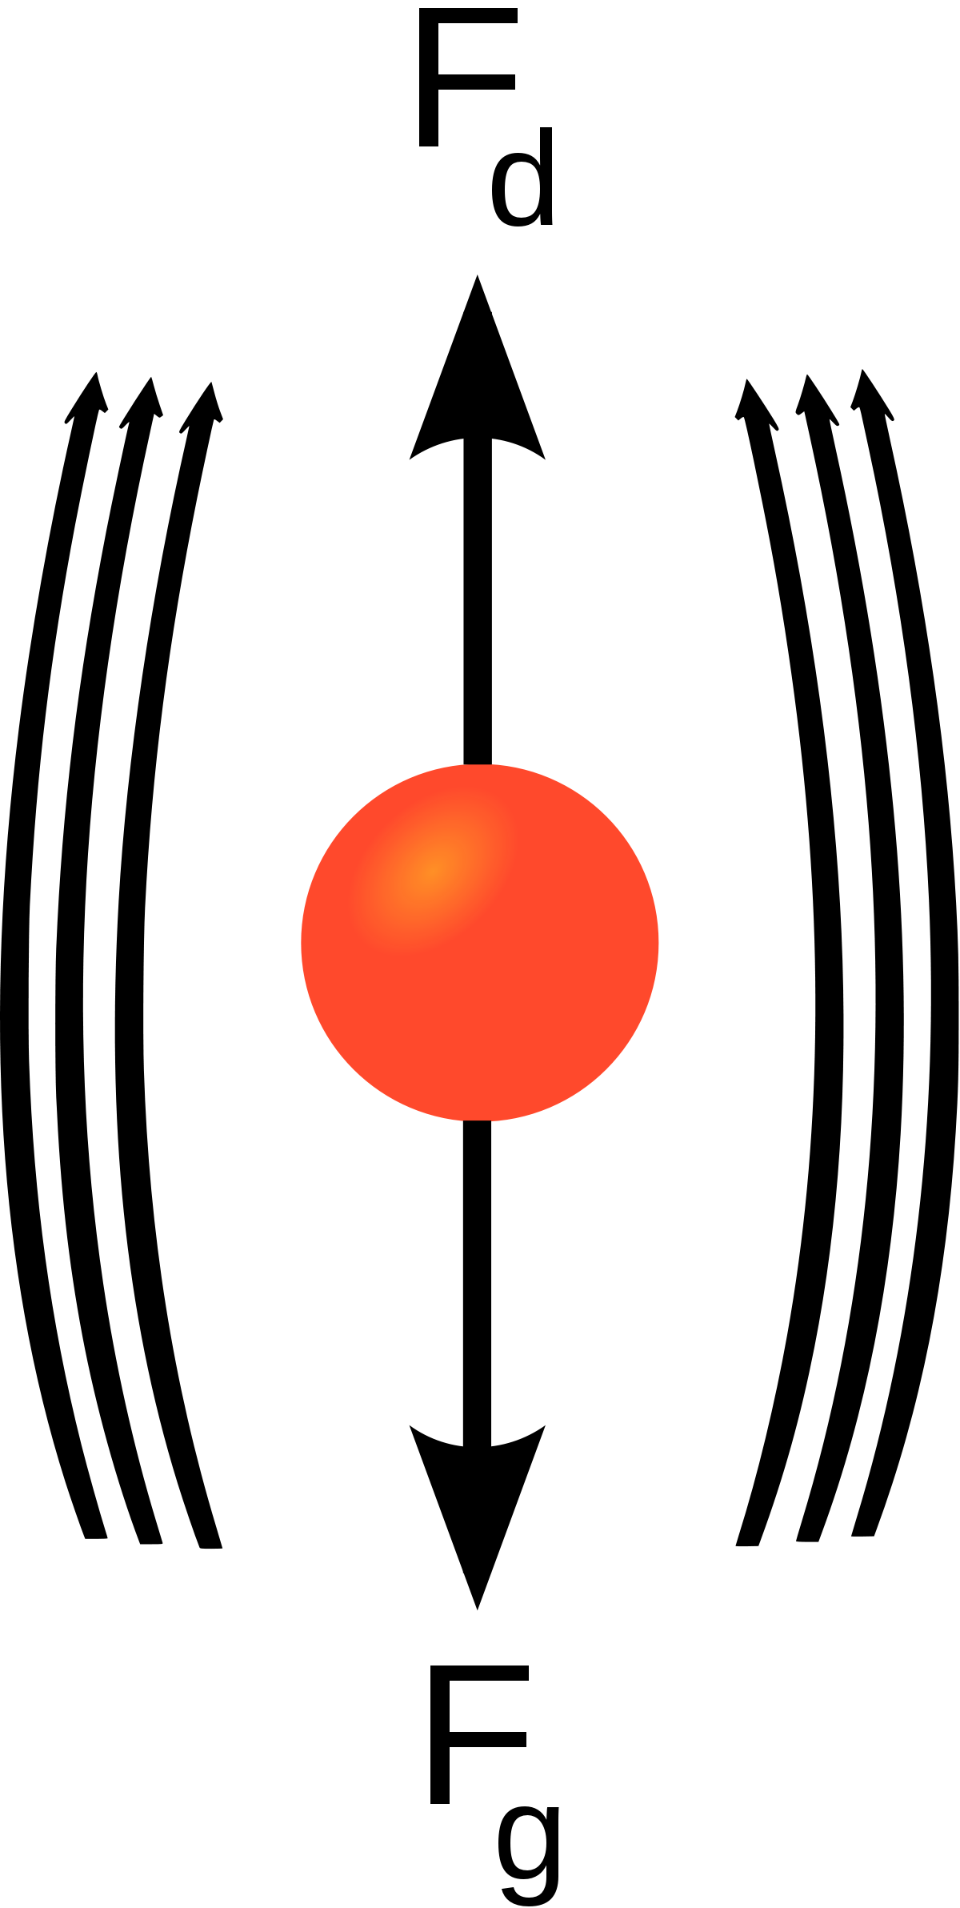
Air Resistance
If allowed to fall for long enough, an object affected by air resistance will eventually reach terminal velocity: a speed at which v_{h} = 0, F_{a} = F_{g} and acceleration stops.
Air resistance always acts in the opposite direction to an object’s motion and is affected by:
The object’s speed (greater speed → more collisions with air particles → more air resistance)
The cross-sectional area of the object in its direction of motion (greater area → more collisions…)
The density of the air (greater density → more collisions…)
How streamlined the object is

Slide 16
Air Resistance
“To the mouse and any smaller animal [gravity] presents practically no dangers. You can drop a mouse down a thousand-yard mine shaft; and, on arriving at the bottom, it gets a slight shock and walks away. A rat is killed, a man is broken, a horse splashes. For the resistance presented to movement by the air is proportional to the surface of the moving object. Divide an animal's length, breadth, and height each by ten; its weight is reduced to a thousandth, but its surface only to a hundredth. So the resistance to falling in the case of the small animal is relatively ten times greater than the driving force.”
J. B. S. Haldane, On Being the Right Size
Notes:
https://archive.org/details/OnBeingTheRightSize-J.B.S.Haldane/page/n3/mode/2up

